Slide 1
Learning with Poor Data
CS771: Introduction to Machine Learning
Purushottam Kar

Slide 2
Learning with Poor Data
Dealing with imbalanced data
Settings where one or more classes receives extremely few data points
Dealing with weakly labelled data
Settings where labels are “coarse” and not in the most helpful form
Dealing with partially labelled data
Settings where part of (or most of) training data points are unlabelled

Slide 3
Learning with Imbalanced Data
Motivating examples from binary/multiclass/multi-label datasets
Techniques to overcome imbalance
Dataset modification
Loss modification
Hybrid techniques

Slide 4
Imbalance is common – Binary Classfn
Valid credit transactions
Don’t have disease
Molecule is inactive
Mail not spam
Fraudulent transactions
Molecule is medicinal
Spam
Mail
Have disease
In anomaly detection, medical diagnosis, drug discovery, spam filtering and many other domains, data is heavily imbalancd
Lots of data may be available in total but very less (0.01% or lesser) may belong to the “rare” class e.g. 100000 red vs 10 green
Trivial for a classifier to get 99.99% accuracy (simply predict everything red)
May be disastrous, e.g. if green class denotes a rare disease or fraudulent transaction
Many ML algorithms that are designed to greedily chase classification accuracy may completely ignore green training data points since it is easy to do well on red data points
The whole purpose of learning is lost if the above happens ☹

Slide 5
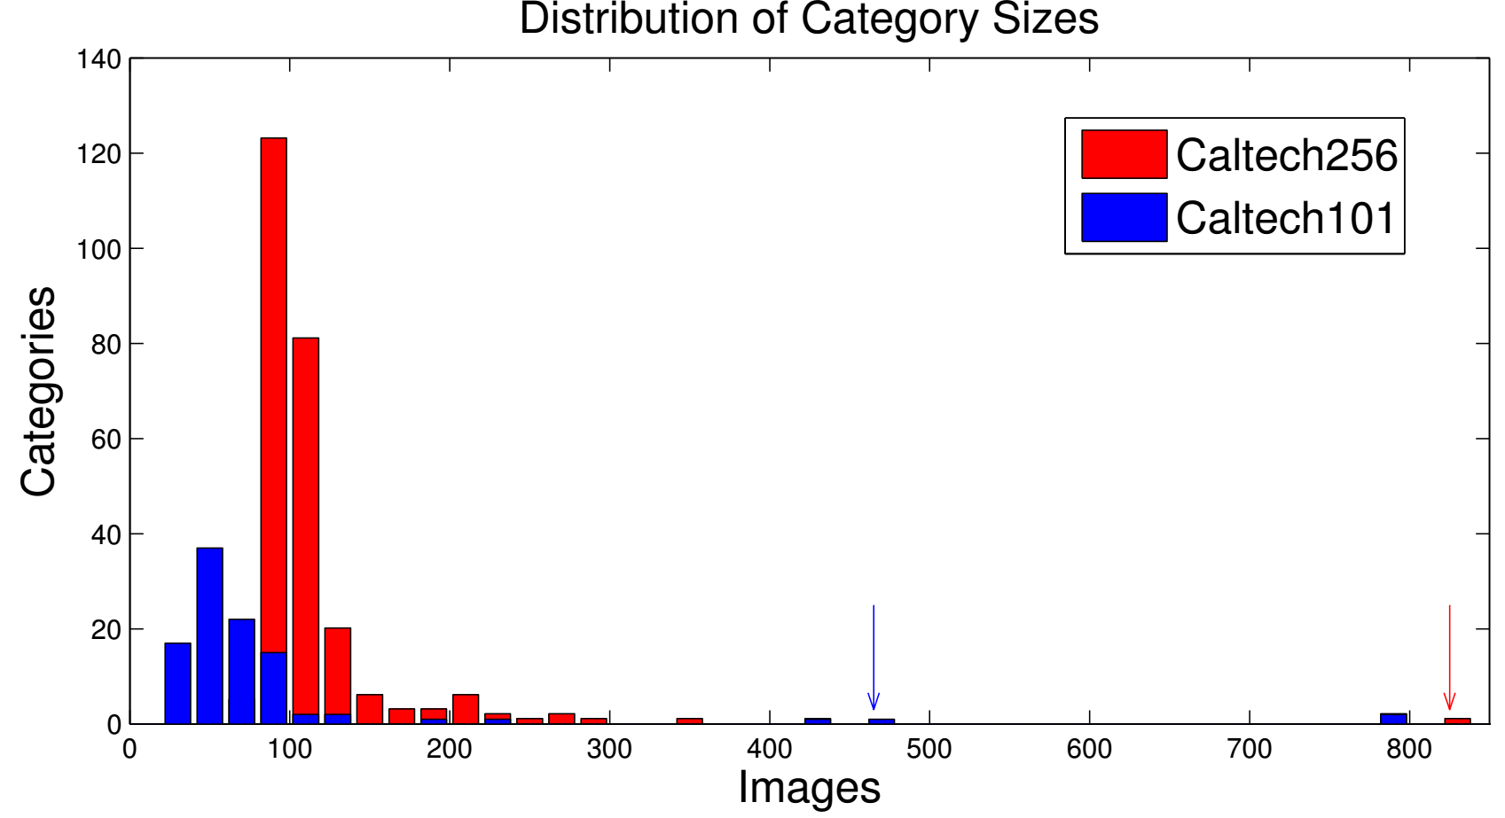
Imbalance is common – Multi Classfn
Caltech-256 is an object detection dataset with 256 classes
Simple averaging argument shows that 50% of classes must each have less than 0.8% of the data
Lots of data for few classes but most classes impoverished
In fact, rarest class has only 80 images, most popular 800 images
Makes learning challenging
Easier to do well on popular classes with lots of data points e.g. cats
Difficult to handle rare classes

Slide 6
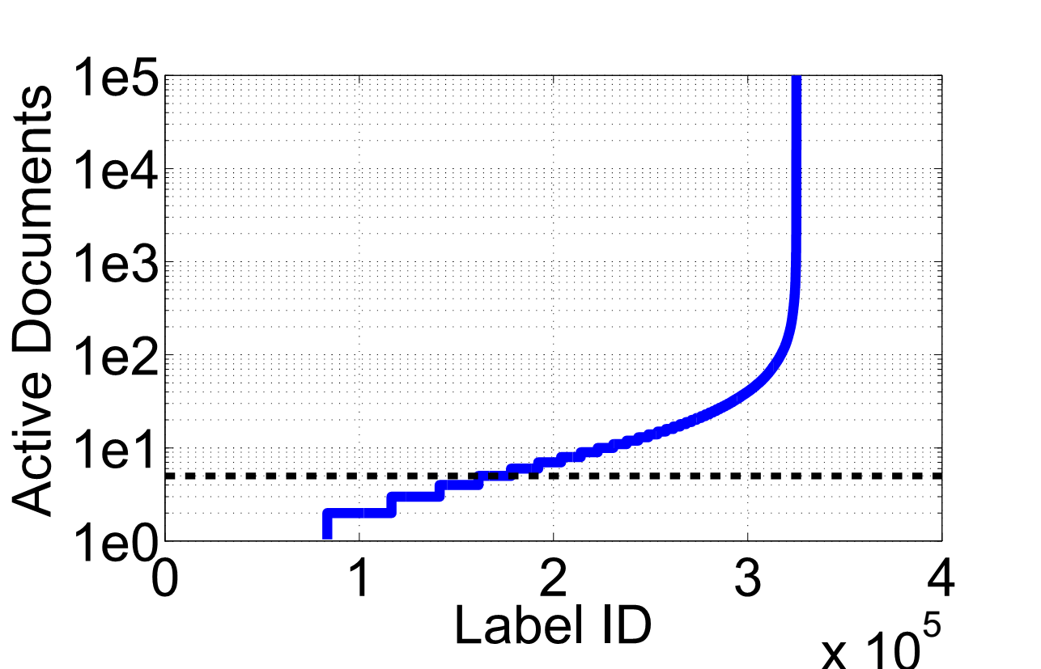
Imbalance is common – Multilabel Classfn
Ironically, although we often proudly refer to these as “big-data” problems, they can often be seen as collections of a huge number of “tiny-data” problems (one tiny data problem per rare label) and a few “reasonable-data” problems
0
0
0
0
0
0
0
0
0
1
0
0
0
1
0
1
0
0
0
0
1
0
0
0
0
0
0
0
0
0
0
0
0
0
0
1
0
0
0
0
0
0
1
0
0
0
0
0
0
0
0
0
0
0
0
0
1
0
0
0
0
0
0
1
0
0
0
0
0
0
0
0
0
0
0
0
0
0
0
1
0
0
0
0
0
0
0
1
0
0
0
0
0
0
0
0
Wikipedia LSHTC is a multilabel dataset with 300000 labels
As many as 150000 labels occur only in less than 5 documents
Most popular label (“living persons”) occurs in 100000 documents
Similar situation in recommendation – most people like iPhone but most items liked by a very select group of individuals
Lots of train data to find out who likes iPhone, not enough for most other items

Slide 7
Solutions to Label Imbalance
Get more data for the rare classes so that they don’t remain rare ☺
Generate artificial data for rare classes to make them more prominent
Change training algorithms that artificially make rare classes prominent
Includes using loss functions that are aware of class imbalance
Use different learning strategies for rare classes and popular classes
A combination of all of the above may be required in practice

Slide 8
Dataset Modification Techniques
A bit pointless to handle label rarity problem by making all labels rare. Would be like a hypothetical administration that aims at equidistribution of wealth but ends up with equidistribution of poverty instead
Undersample the popular class so that it does not dominate
Actually throwing out data not a very good idea since it throws away data
In practice we may give smaller weights to popular class points
Oversample the rare class by repeating each rare point (say 100 times)
Not done explicitly since that would needlessly increase train set size+time
Implicitly done by giving higher weights to rare class points
A technique SMOTE (Synthetic Minority Oversampling TEchnique) however actually samples new data points around rare class points

Slide 9
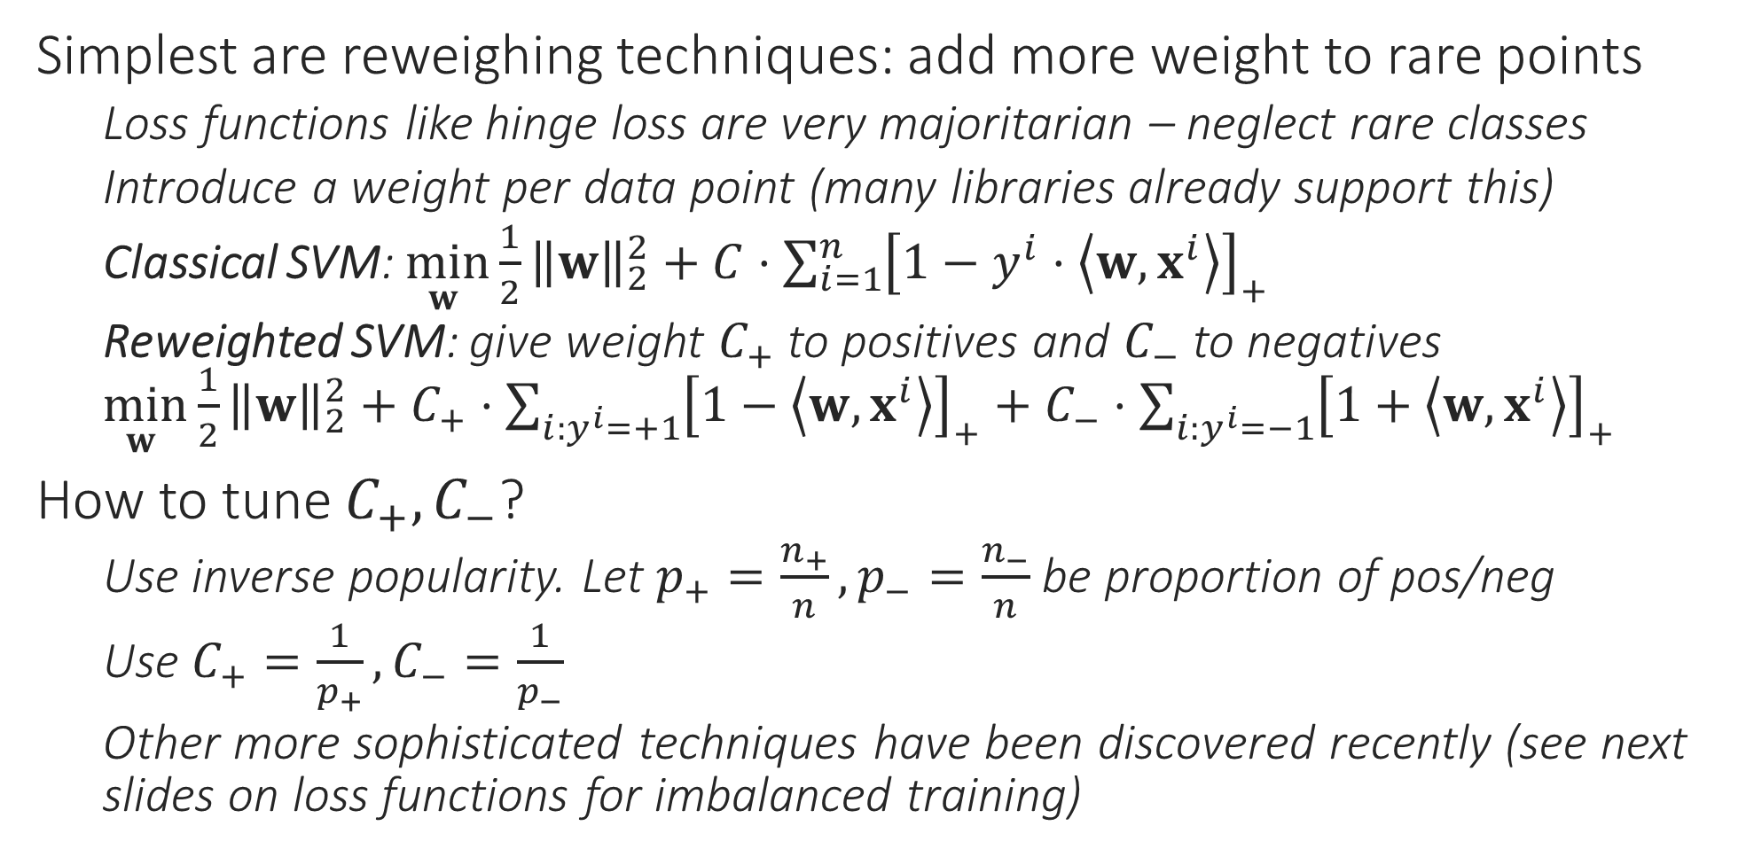
Imbalance-aware Training Techniques
Simplest are reweighing techniques: add more weight to rare points
Loss functions like hinge loss are very majoritarian – neglect rare classes
Introduce a weight per data point (many libraries already support this)
Classical SVM: $\min_{w }{\frac{1}{2}{\left\|w\right\|}_{2}^{2}}+C⋅\sum_{i=1}^{n}{{\left[1−y^{i}⋅\left\langle w,x^{i}\right\rangle \right]}_{+}}$
Reweighted SVM: give weight $C_{+}$ to positives and $C_{−}$ to negatives $\min_{w }{\frac{1}{2}{\left\|w\right\|}_{2}^{2}}+C_{+}⋅\sum_{i:y^{i}=+1}{{\left[1−\left\langle w,x^{i}\right\rangle \right]}_{+}}+C_{−}⋅\sum_{i:y^{i}=−1}{{\left[1+\left\langle w,x^{i}\right\rangle \right]}_{+}}$
How to tune $C_{+},C_{−}$?
Use inverse popularity. Let $p_{+}=\frac{n_{+}}{n},p_{−}=\frac{n_{−}}{n}$ be proportion of pos/neg
Use $C_{+}=\frac{1}{p_{+}},C_{−}=\frac{1}{p_{−}}$
Other more sophisticated techniques have been discovered recently (see next slides on loss functions for imbalanced training)

Slide 10
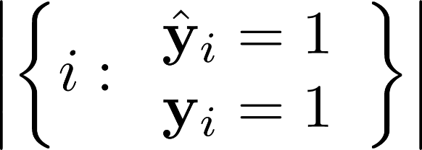
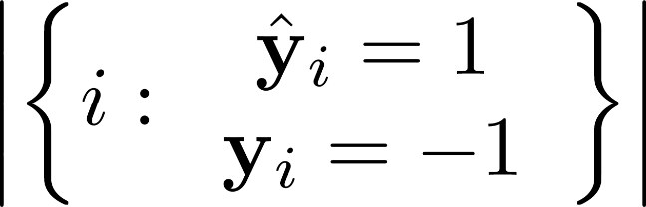
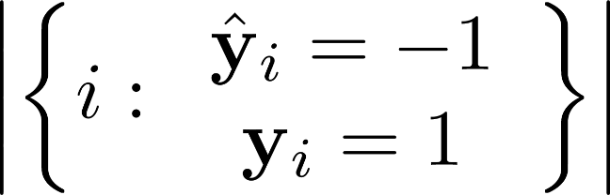
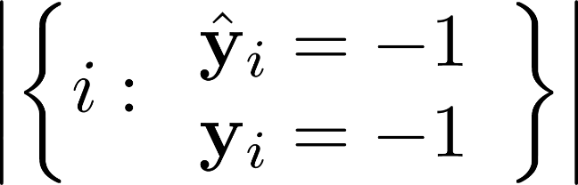


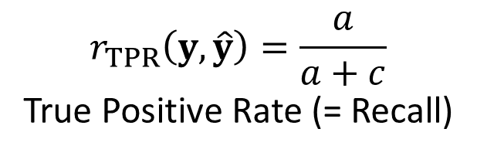
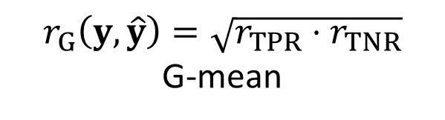
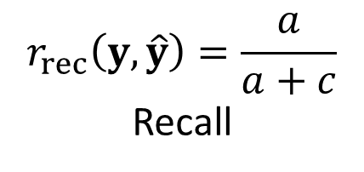
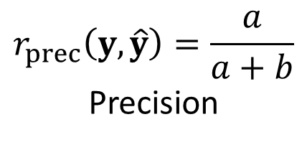
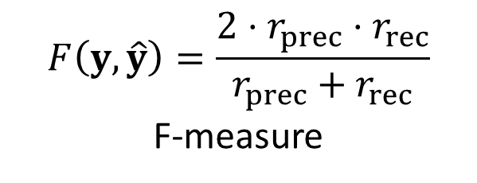
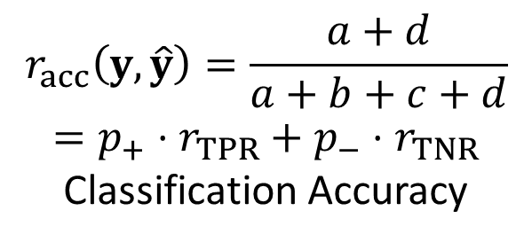
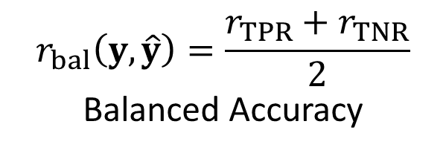
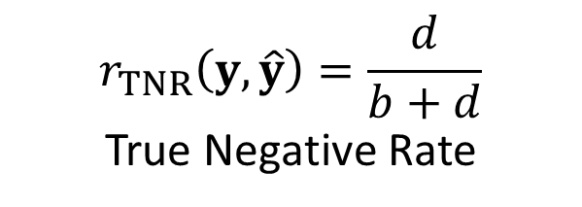
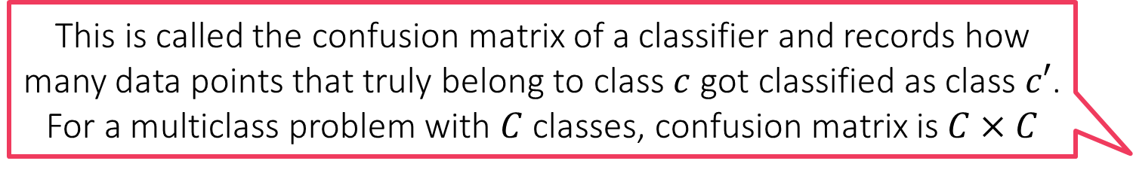
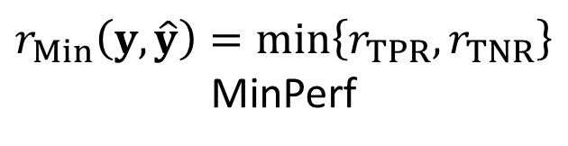
Imbalance-aware Training Techniques
This is called the confusion matrix of a classifier and records how many data points that truly belong to class $c$ got classified as class $c′$. For a multiclass problem with $C$ classes, confusion matrix is $C×C$
Use loss fns that themselves penalize models that neglect rare classes
a
b
$$r_{acc}\left(y,\hat{y}\right)=\frac{a+d}{a+b+c+d}$$
$$=p_{+}⋅r_{TPR}+p_{−}⋅r_{TNR}$$
Classification Accuracy
c
d
$$r_{bal}\left(y,\hat{y}\right)=\frac{r_{TPR}+r_{TNR}}{2}$$
Balanced Accuracy
$$r_{TPR}\left(y,\hat{y}\right)=\frac{a}{a+c}$$
True Positive Rate (= Recall)
$$r_{TNR}\left(y,\hat{y}\right)=\frac{d}{b+d}$$
True Negative Rate
$$r_{prec}\left(y,\hat{y}\right)=\frac{a}{a+b}$$
Precision
$$F\left(y,\hat{y}\right)=\frac{2⋅r_{prec}⋅r_{rec}}{r_{prec}+r_{rec}}$$
F-measure
$$r_{G}\left(y,\hat{y}\right)=\sqrt{r_{TPR}⋅r_{TNR}}$$
G-mean
$$r_{rec}\left(y,\hat{y}\right)=\frac{a}{a+c}$$
Recall
$$r_{Min}\left(y,\hat{y}\right)=\min\left\{r_{TPR},r_{TNR}\right\}$$
MinPerf
10

Slide 11
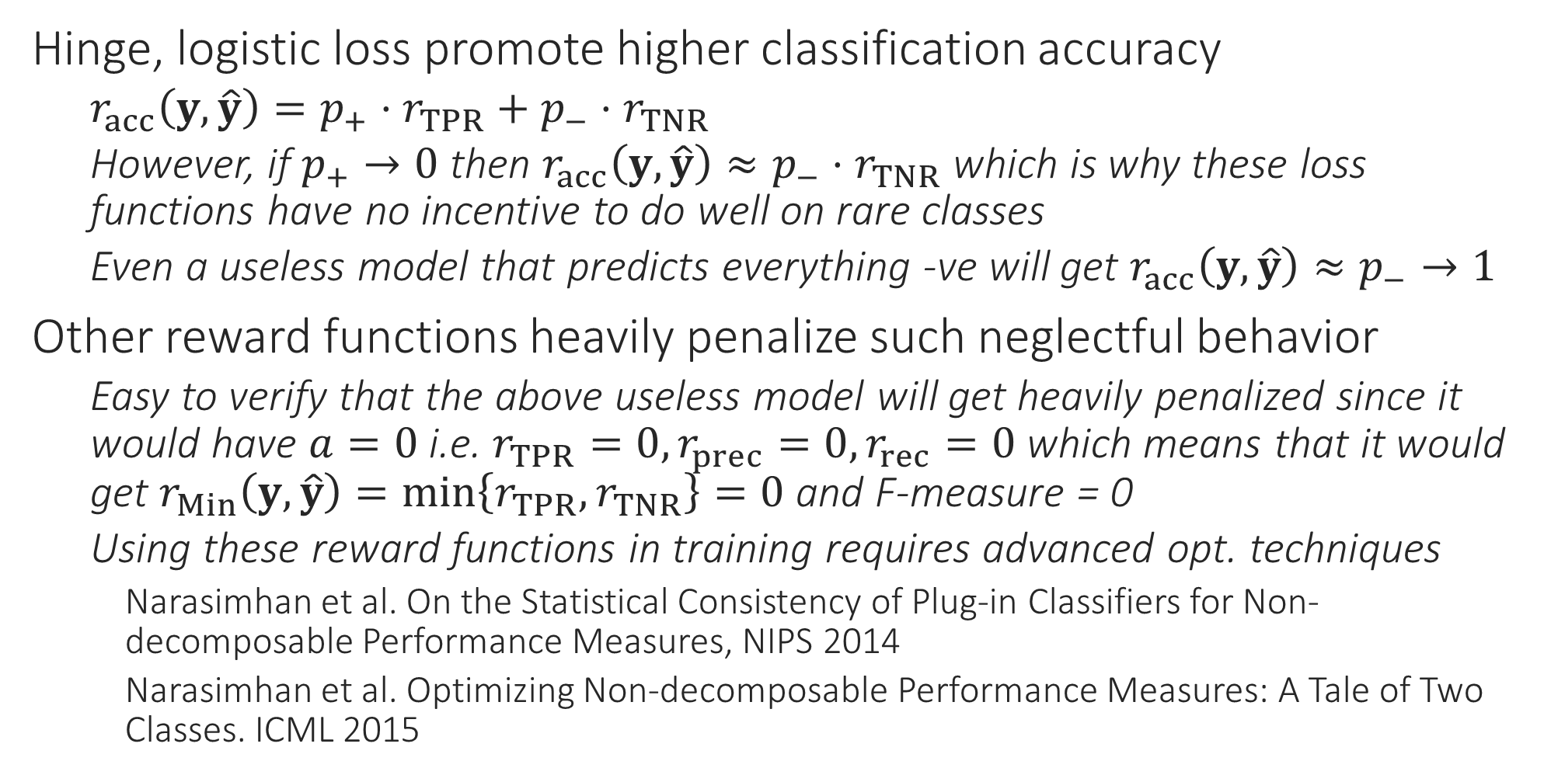
Imbalance-aware Training Techniques
Hinge, logistic loss promote higher classification accuracy
$r_{acc}\left(y,\hat{y}\right)=p_{+}⋅r_{TPR}+p_{−}⋅r_{TNR}$
However, if $p_{+}→0$ then $r_{acc}\left(y,\hat{y}\right)≈p_{−}⋅r_{TNR}$ which is why these loss functions have no incentive to do well on rare classes
Even a useless model that predicts everything -ve will get $r_{acc}\left(y,\hat{y}\right)≈p_{−}→1$
Other reward functions heavily penalize such neglectful behavior
Easy to verify that the above useless model will get heavily penalized since it would have $a=0$ i.e. $r_{TPR}=0,r_{prec}=0,r_{rec}=0$ which means that it would get $r_{Min}\left(y,\hat{y}\right)=\min\left\{r_{TPR},r_{TNR}\right\}=0$ and F-measure = 0
Using these reward functions in training requires advanced opt. techniques
Narasimhan et al. On the Statistical Consistency of Plug-in Classifiers for Non-decomposable Performance Measures, NIPS 2014
Narasimhan et al. Optimizing Non-decomposable Performance Measures: A Tale of Two Classes. ICML 2015

Slide 12
Imbalance-aware Training Techniques
1
Another technique is to treat classification problems as ranking problems instead
For binary problems, this is done by asking the model to assign scores to data points and try to give high scores to +ve points and low scores to -ve points
Next, data points are ranked according to their scores
Note: here we do not threshold scores at 0 to arrive labels
This ranking is used to assign loss/reward to the model
Model is rewarded if lots of positives are in top positions
Model is penalized if negatives pollute the ranking
Such loss fns are key in multiclass/label learning too
For multiclass/label, instead of ranking data points, we ask model to rank classes from most likely to least likely for each data point e.g. rank items for each user
7
3
5
8
2
4
6

Slide 13
Imbalance-aware Training Techniques
Advanced techniques exist to even optimize these on training data.
Zhao et al, Online AUC Maximization, ICML 2011
K. et al, Surrogate Functions for Maximizing Precision at the Top, ICML 2015
1
Bipartite Ranking Loss (AUC loss)
Counts # times a -ve point was ranked above a +ve point divided by product of # +ves and # -ves
In this cartoon example, this mistake was committed 3 times and #+ves = 3, #-ves = 5 so AUC loss is 3/(3*5) = 0.2
Precision@k
Counts # +ves present in top k positions divided by k
Recall@k
Counts # +ves present in top k positives divided by #+ves
MAP (Mean average Precision)
Finds the average reciprocal rank at which +ves were predicted. In this cartoon this is (1/1+1/3+1/5) = 1.533
7
3
5
8
2
4
6

Slide 14
Hybrid Learning Strategies
It is folklore in ML that discriminative models do better when lots of data is available but generative models do better with less data
Ng and Jordan, On Discriminative vs. Generative classifiers, NIPS 2001
For popular classes with lots of data, safe to use discriminative techniques like kernels, trees, deep nets along with one-vs-all etc
For rare classes with less data, may try generative techniques like naive Bayes, GMM or even LwP
Hybrid strategies are often used in recommendation systems
Rocchio classifiers, reranking algorithms etc
Use a standard discriminative algorithm e.g. trees etc to rank all labels but then use LwP-style techniques to boost the ranks of rare labels so that they do not get lost
Jain et al. Extreme Multi-label Loss Functions for Recommendation, KDD 2016

Slide 15
Learning with Weak Labels
Motivating examples from computer vision, NLP
Casting weak supervision as “multi-instance” learning
Techniques to solve multi-instance learning

Slide 16
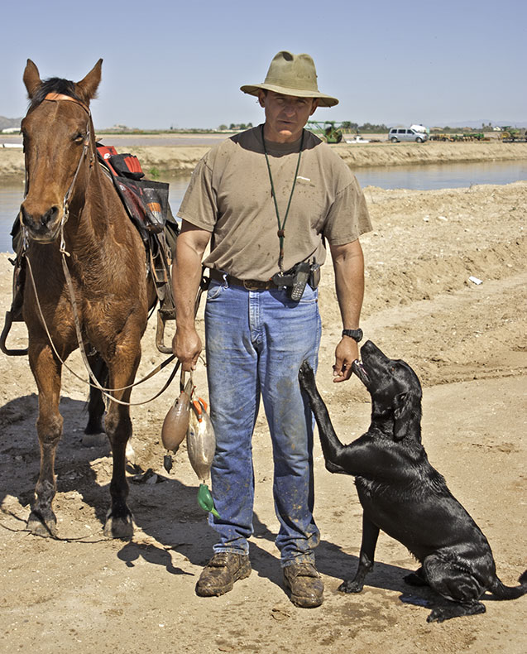
Weak Supervision in Vision
“Strong” supervision
Weak supervision
Refers to supervision at a high level
Related concepts – distant supervision, multi-instance learning
In the weak supervision case, the locations of objects not labelled
More effort to label
Less effort to label
Man, Horse, Dog
Man, Horse, Dog

Slide 17
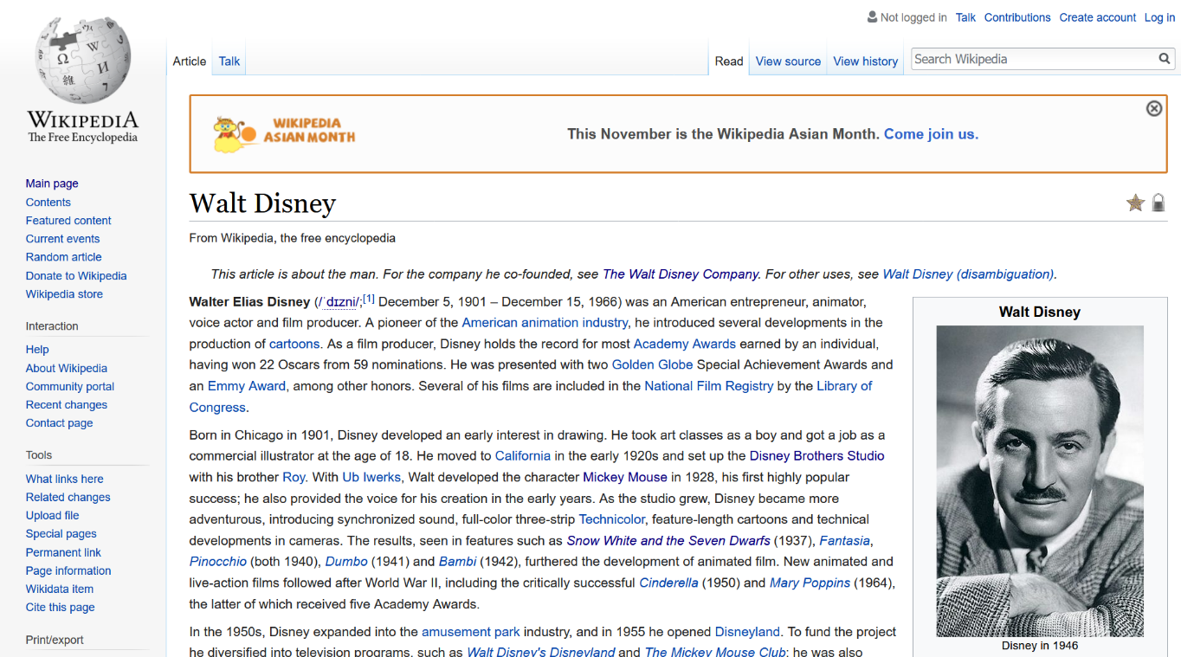
Weak Supervision in NLP
Supervision at high level – distant supervision, multi-instance learning
Relation extraction problem
In “fine” supervision, every sentence would be labelled with the relation
In “distant” supervision, we are not told which sentence signalled the relation
Weak supervision
“Strong” supervision
CREATE(WALT DISNEY, MICKEY MOUSE)
CREATE(WALT DISNEY, MICKEY MOUSE)

Slide 18
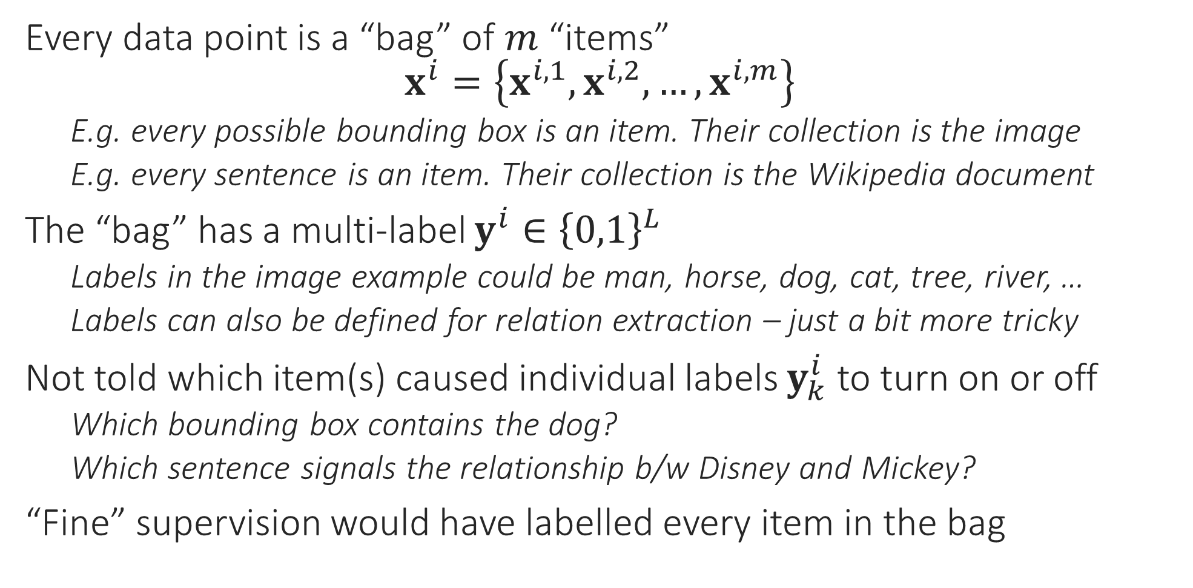
Weak Labels as Multi-instance Learning
Every data point is a “bag” of $m$ “items” $x^{i}=\left\{x^{i,1},x^{i,2},…,x^{i,m}\right\}$
E.g. every possible bounding box is an item. Their collection is the image
E.g. every sentence is an item. Their collection is the Wikipedia document
The “bag” has a multi-label $y^{i}∈{\left\{0,1\right\}}^{L}$
Labels in the image example could be man, horse, dog, cat, tree, river, …
Labels can also be defined for relation extraction – just a bit more tricky
Not told which item(s) caused individual labels $y_{k}^{i}$ to turn on or off
Which bounding box contains the dog?
Which sentence signals the relationship b/w Disney and Mickey?
“Fine” supervision would have labelled every item in the bag

Slide 19
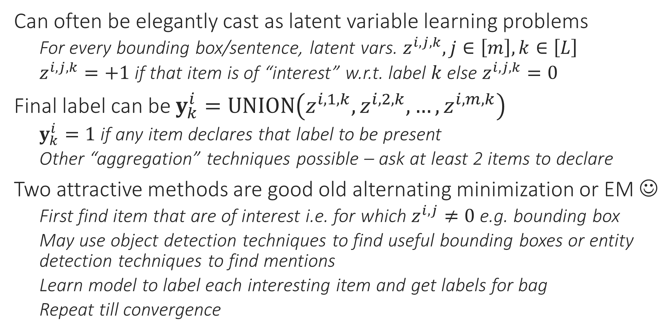
Solutions for Multi-instance Learning
Can often be elegantly cast as latent variable learning problems
For every bounding box/sentence, latent vars. $z^{i,j,k}, j∈\left[m\right],k∈\left[L\right]$
$z^{i,j,k}=+1$ if that item is of “interest” w.r.t. label $k$ else $z^{i,j,k}=0$
Final label can be $y_{k}^{i}=UNION\left(z^{i,1,k},z^{i,2,k},…,z^{i,m,k}\right)$
$y_{k}^{i}=1$ if any item declares that label to be present
Other “aggregation” techniques possible – ask at least 2 items to declare
Two attractive methods are good old alternating minimization or EM ☺
First find item that are of interest i.e. for which $z^{i,j}≠0$ e.g. bounding box
May use object detection techniques to find useful bounding boxes or entity detection techniques to find mentions
Learn model to label each interesting item and get labels for bag
Repeat till convergence

Slide 20
Learning with Partial Labels
Cases when all/most of training data is unlabelled
Active learning: when a teacher is available from whom labels can be requested for a limited number of data points
Semi supervised learning: no teacher available to provide additional labels on the fly – must work with what we have

Slide 21
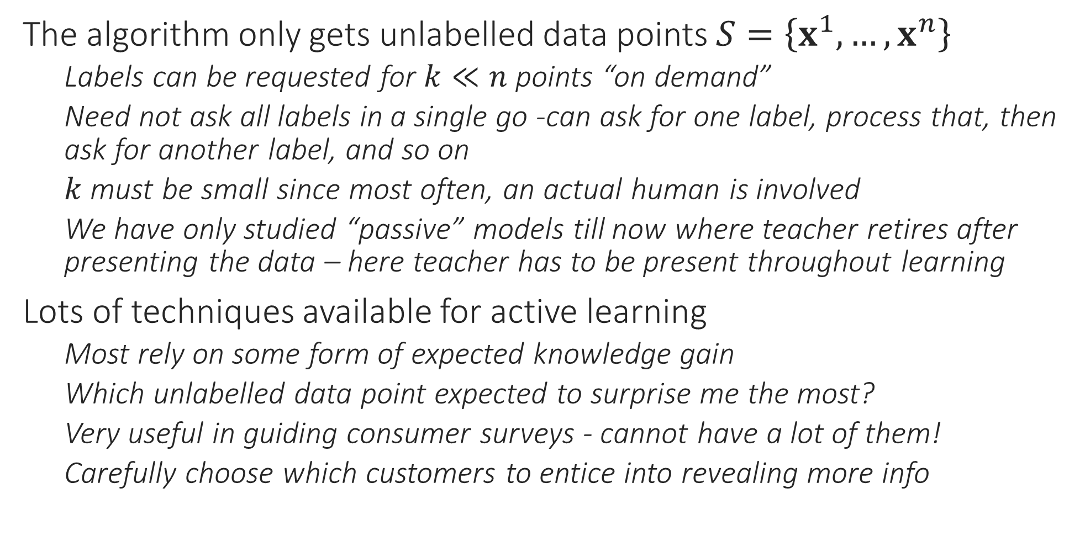
Active Learning
The algorithm only gets unlabelled data points $S=\left\{x^{1},…,x^{n}\right\}$
Labels can be requested for $k≪n$ points “on demand”
Need not ask all labels in a single go -can ask for one label, process that, then ask for another label, and so on
$k$ must be small since most often, an actual human is involved
We have only studied “passive” models till now where teacher retires after presenting the data – here teacher has to be present throughout learning
Lots of techniques available for active learning
Most rely on some form of expected knowledge gain
Which unlabelled data point expected to surprise me the most?
Very useful in guiding consumer surveys - cannot have a lot of them!
Carefully choose which customers to entice into revealing more info

Slide 22
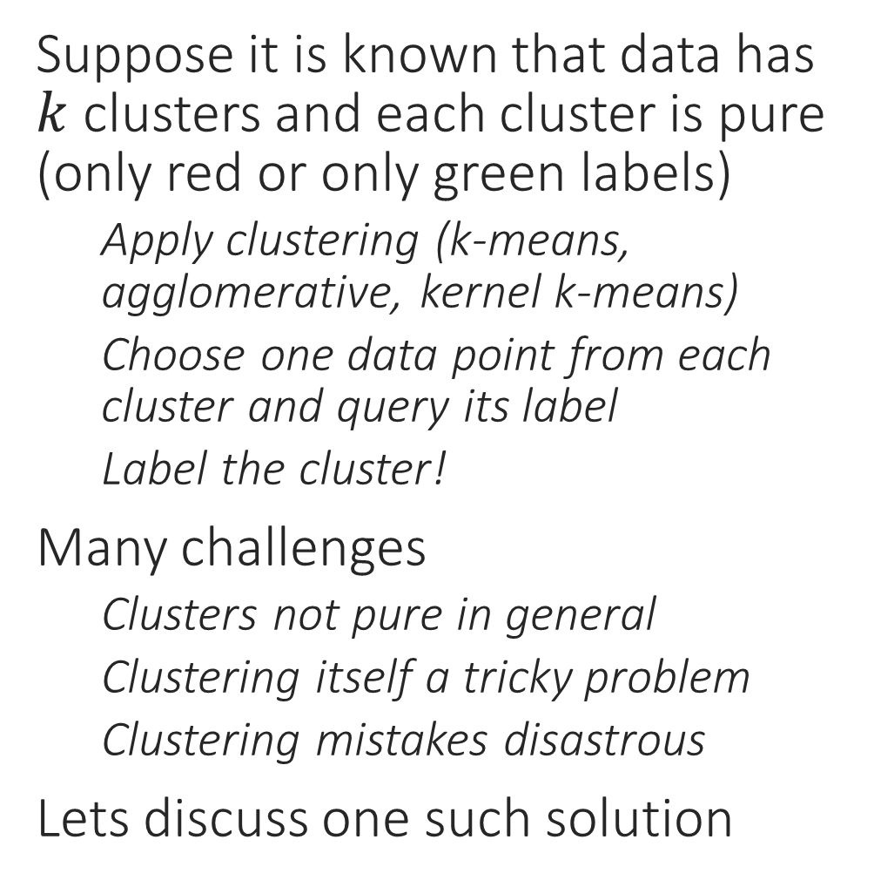
Active Learning Attempt 0
Suppose it is known that data has $k$ clusters and each cluster is pure (only red or only green labels)
Apply clustering (k-means, agglomerative, kernel k-means)
Choose one data point from each cluster and query its label
Label the cluster!
Many challenges
Clusters not pure in general
Clustering itself a tricky problem
Clustering mistakes disastrous
Lets discuss one such solution

Slide 23
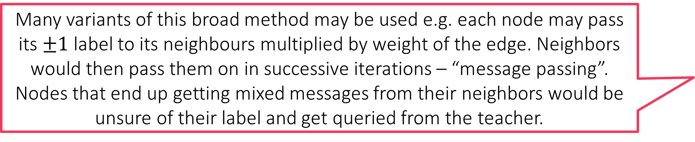
Active Learning via Label Propagation
Many variants of this broad method may be used e.g. each node may pass its $±1$ label to its neighbours multiplied by weight of the edge. Neighbors would then pass them on in successive iterations – “message passing”. Nodes that end up getting mixed messages from their neighbors would be unsure of their label and get queried from the teacher.
Cluster and get labels for cluster representatives
Create a “similarity graph” over data points
May use a Mercer kernel for edge weights
Don’t include edges with very small weight – sparse graph!
“Propagate” labels from labelled to unlabelled points
Query unlabelled data points that are “confused”
Repeat!

Slide 24


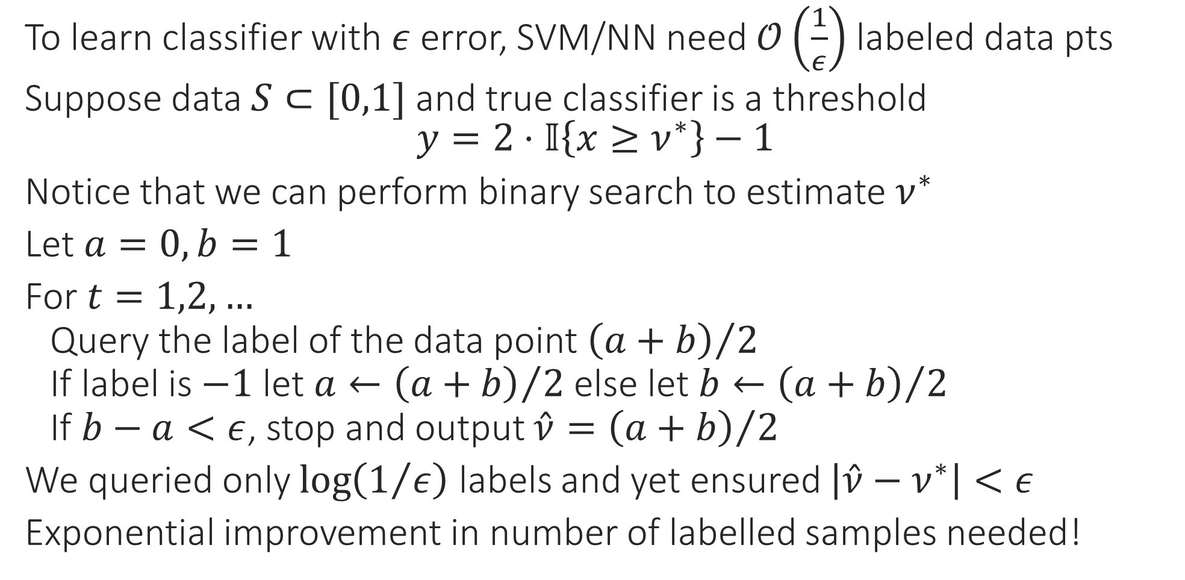



Active Learning via Version-space Search
To learn classifier with $ε$ error, SVM/NN need $𝒪\left(\frac{1}{ε}\right)$ labeled data pts
Suppose data $S⊂[0,1]$ and true classifier is a threshold
$$y=2⋅𝕀\left\{x≥ν^{∗}\right\}−1$$
Notice that we can perform binary search to estimate $ν^{∗}$
Let $a=0,b=1$
For $t=1,2,…$
Query the label of the data point ${\left(a+b\right)}/2$
If label is $−1$ let $a←{\left(a+b\right)}/2$ else let $b←{\left(a+b\right)}/2$
If $b−a<ε$, stop and output $\hat{ν}={\left(a+b\right)}/2$
We queried only $\log\left(1/ε\right)$ labels and yet ensured $\left|\hat{ν}−ν^{∗}\right|<ε$
Exponential improvement in number of labelled samples needed!
$$[$$
$$]$$
$$0$$
$$ν^{∗}$$
$$1$$

Slide 25
Active Learning
What we saw in the previous slide is the most simple form of what is called version space search where we search space of all classifiers
E.g. classifiers corresponded to thresholds in the toy example
This can get challenging very quickly even for linear classifiers
Several other methods exist to perform active learning
Using boosting (see ActBoost if interested)
In Bayesian models, query data point with largest predictive posterior variance
Query-by-committee – maintain a committee of several models and query data points on which the committee disagrees the most (disagreement coefficient)
Expected model drift – maintain a single model but query the data point whose label, if known, will change the model the most

Slide 26
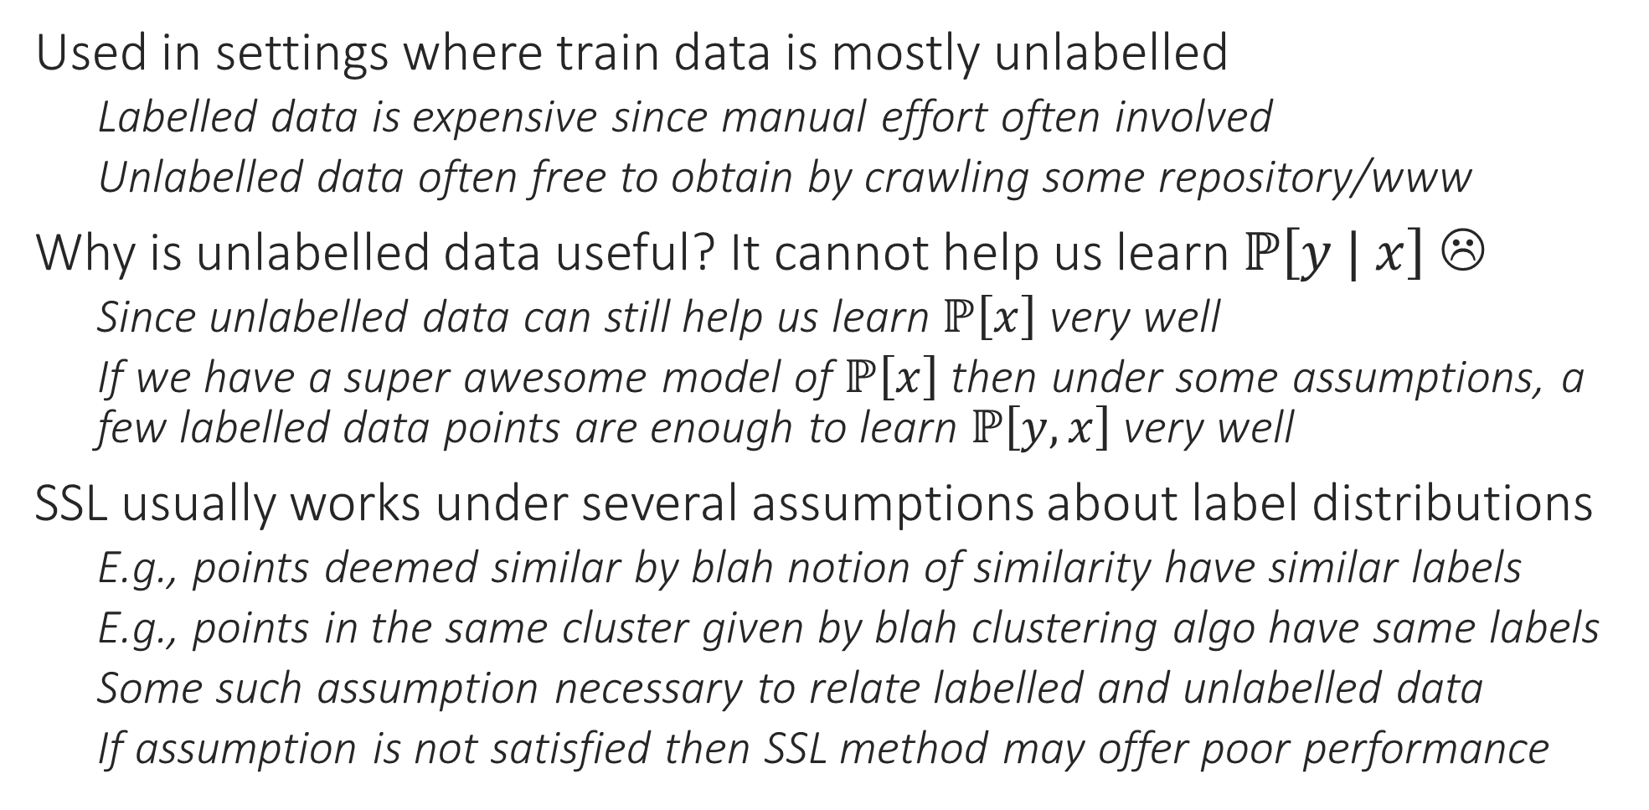
Semi-supervised Learning
Used in settings where train data is mostly unlabelled
Labelled data is expensive since manual effort often involved
Unlabelled data often free to obtain by crawling some repository/www
Why is unlabelled data useful? It cannot help us learn $ℙ\left[y | x\right]$ ☹
Since unlabelled data can still help us learn $ℙ\left[x\right]$ very well
If we have a super awesome model of $ℙ\left[x\right]$ then under some assumptions, a few labelled data points are enough to learn $ℙ\left[y,x\right]$ very well
SSL usually works under several assumptions about label distributions
E.g., points deemed similar by blah notion of similarity have similar labels
E.g., points in the same cluster given by blah clustering algo have same labels
Some such assumption necessary to relate labelled and unlabelled data
If assumption is not satisfied then SSL method may offer poor performance

Slide 27
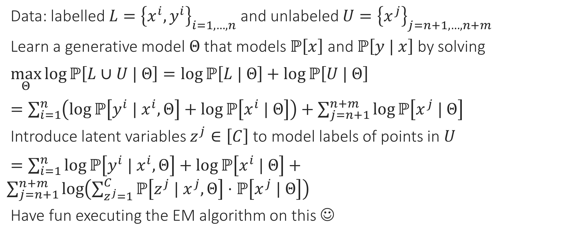
SSL via Generative Learning
Data: labelled $L={\left\{x^{i},y^{i}\right\}}_{i=1,…,n}$ and unlabeled $U={\left\{x^{j}\right\}}_{j=n+1,…,n+m}$
Learn a generative model $Θ$ that models $ℙ\left[x\right]$ and $ℙ\left[y | x\right]$ by solving
$\max_{Θ}\log{ℙ\left[L∪U | Θ\right]}=\log{ℙ\left[L | Θ\right]}+\log{ℙ\left[U | Θ\right]}$
$=\sum_{i=1}^{n}{\left(\log{ℙ\left[y^{i} | x^{i},Θ\right]}+\log{ℙ\left[x^{i} | Θ\right]}\right)}+\sum_{j=n+1}^{n+m}{\log{ℙ\left[x^{j} | Θ\right]}}$
Introduce latent variables $z^{j}∈\left[C\right]$ to model labels of points in $U$
$=\sum_{i=1}^{n}{\log{ℙ\left[y^{i} | x^{i},Θ\right]}+\log{ℙ\left[x^{i} | Θ\right]}}+\sum_{j=n+1}^{n+m}{\log\left(\sum_{z^{j}=1}^{C}{ℙ\left[z^{j} | x^{j},Θ\right]⋅ℙ\left[x^{j} | Θ\right]}\right)}$
Have fun executing the EM algorithm on this ☺

Slide 28
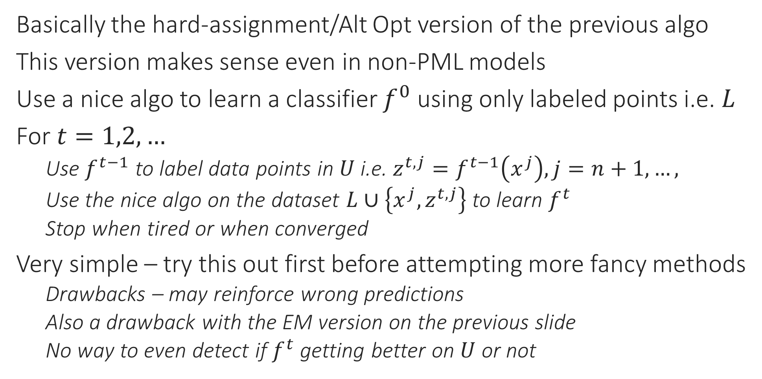
SSL via Bootstrapping
Basically the hard-assignment/Alt Opt version of the previous algo
This version makes sense even in non-PML models
Use a nice algo to learn a classifier $f^{0}$ using only labeled points i.e. $L$
For $t=1,2,…$
Use $f^{t−1}$ to label data points in $U$ i.e. $z^{t,j}=f^{t−1}\left(x^{j}\right),j=n+1, …,$
Use the nice algo on the dataset $L∪\left\{x^{j},z^{t,j}\right\}$ to learn $f^{t}$
Stop when tired or when converged
Very simple – try this out first before attempting more fancy methods
Drawbacks – may reinforce wrong predictions
Also a drawback with the EM version on the previous slide
No way to even detect if $f^{t}$ getting better on $U$ or not

Slide 29
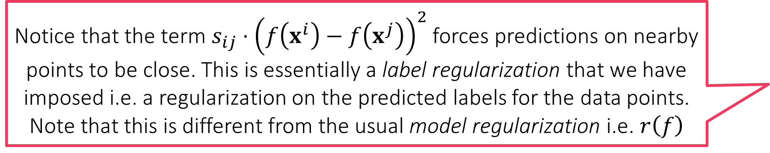
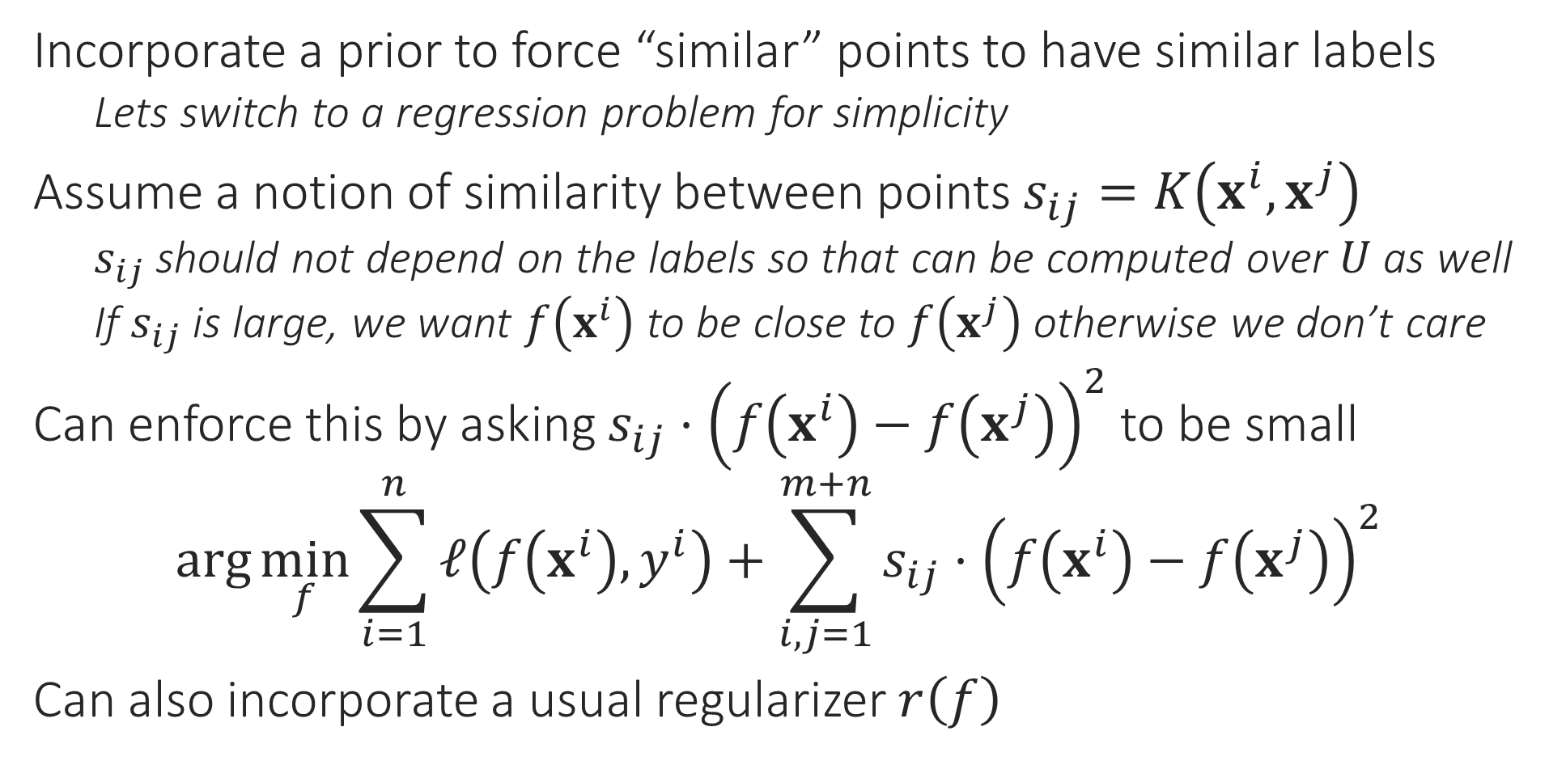
SSL via Regularized Label Propagation
Notice that the term $s_{ij}⋅{\left(f\left(x^{i}\right)−f\left(x^{j}\right)\right)}^{2}$ forces predictions on nearby points to be close. This is essentially a label regularization that we have imposed i.e. a regularization on the predicted labels for the data points. Note that this is different from the usual model regularization i.e. $r\left(f\right)$
Incorporate a prior to force “similar” points to have similar labels
Lets switch to a regression problem for simplicity
Assume a notion of similarity between points $s_{ij}=K\left(x^{i},x^{j}\right)$
$s_{ij}$ should not depend on the labels so that can be computed over $U$ as well
If $s_{ij}$ is large, we want $f\left(x^{i}\right)$ to be close to $f\left(x^{j}\right)$ otherwise we don’t care
Can enforce this by asking $s_{ij}⋅{\left(f\left(x^{i}\right)−f\left(x^{j}\right)\right)}^{2}$ to be small
$$\arg{\min_{f}{\sum_{i=1}^{n}{ℓ\left(f\left(x^{i}\right),y^{i}\right)}+\sum_{i,j=1}^{m+n}{s_{ij}⋅{\left(f\left(x^{i}\right)−f\left(x^{j}\right)\right)}^{2}}}}$$
Can also incorporate a usual regularizer $r\left(f\right)$

Slide 30
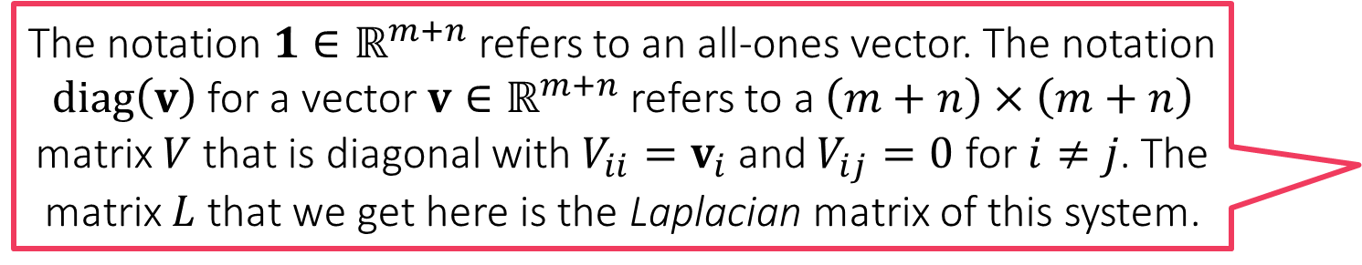
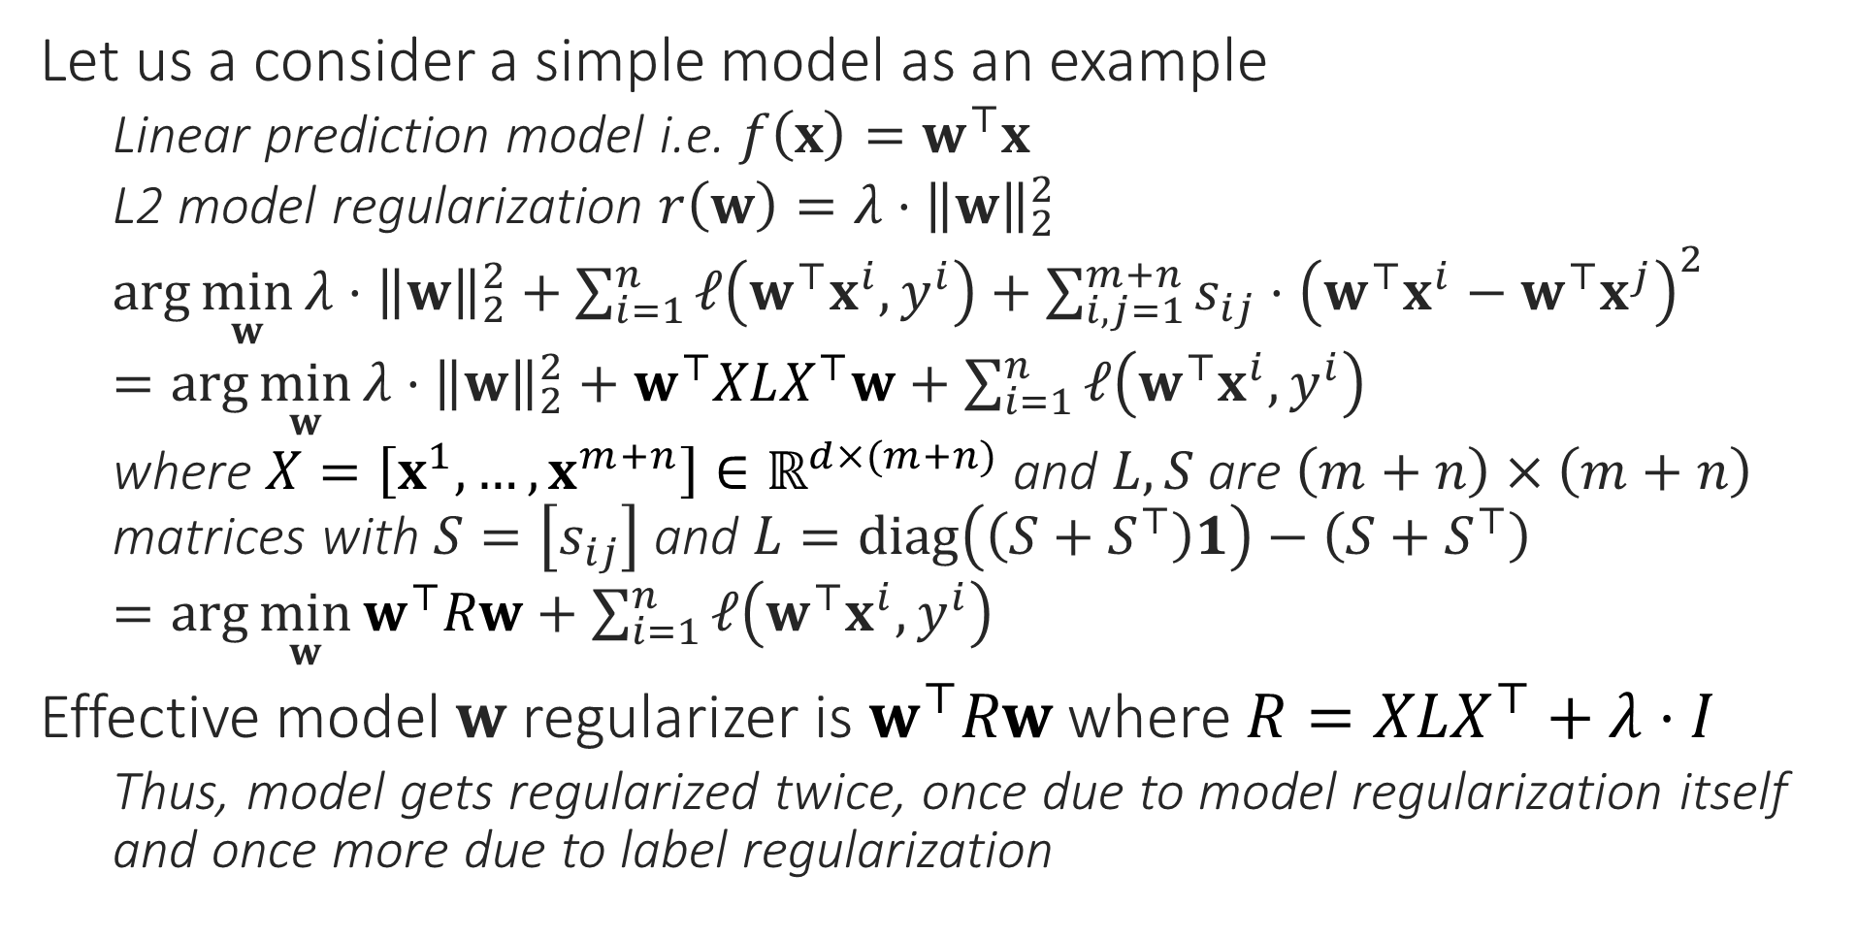
SSL via Regularized Label Propagation
The notation $1∈ℝ^{m+n}$ refers to an all-ones vector. The notation $diag\left(v\right)$ for a vector $v∈ℝ^{m+n}$ refers to a $\left(m+n\right)×\left(m+n\right)$ matrix $V$ that is diagonal with $V_{ii}=v_{i}$ and $V_{ij}=0$ for $i≠j$. The matrix $L$ that we get here is the Laplacian matrix of this system.
Let us a consider a simple model as an example
Linear prediction model i.e. $f\left(x\right)=w^{⊤}x$
L2 model regularization $r\left(w\right)={λ⋅\left\|w\right\|}_{2}^{2}$
$\arg{\min_{w}{{λ⋅\left\|w\right\|}_{2}^{2}+\sum_{i=1}^{n}{ℓ\left(w^{⊤}x^{i},y^{i}\right)}+\sum_{i,j=1}^{m+n}{s_{ij}⋅{\left(w^{⊤}x^{i}−w^{⊤}x^{j}\right)}^{2}}}}$
$=\arg{\min_{w}{{λ⋅\left\|w\right\|}_{2}^{2}+w^{⊤}XLX^{⊤}w+\sum_{i=1}^{n}{ℓ\left(w^{⊤}x^{i},y^{i}\right)}}}$
where $X=\left[x^{1},…,x^{m+n}\right]∈ℝ^{d×(m+n)}$ and $L,S$ are $\left(m+n\right)×\left(m+n\right)$ matrices with $S=\left[s_{ij}\right]$ and $L=diag\left(\left(S+S^{⊤}\right)1\right)−\left(S+S^{⊤}\right)$
$=\arg{\min_{w}{w^{⊤}Rw+\sum_{i=1}^{n}{ℓ\left(w^{⊤}x^{i},y^{i}\right)}}}$
Effective model $w$ regularizer is $w^{⊤}Rw$ where $R=XLX^{⊤}+λ⋅I$
Thus, model gets regularized twice, once due to model regularization itself and once more due to label regularization

Slide 31
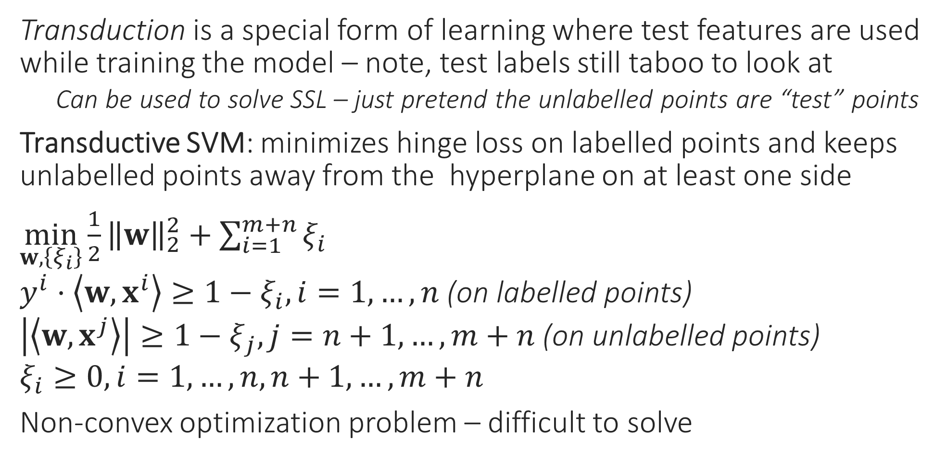
SSL via Transductive SVMs
Transduction is a special form of learning where test features are used while training the model – note, test labels still taboo to look at
Can be used to solve SSL – just pretend the unlabelled points are “test” points
Transductive SVM: minimizes hinge loss on labelled points and keeps unlabelled points away from the hyperplane on at least one side
$\min_{w,\left\{ξ_{i}\right\}}{\frac{1}{2}{\left\|w\right\|}_{2}^{2}+\sum_{i=1}^{m+n}{ξ_{i}}}$ $y^{i}⋅\left\langle w,x^{i}\right\rangle ≥1−ξ_{i},i=1,…,n$ (on labelled points) $\left|\left\langle w,x^{j}\right\rangle \right|≥1−ξ_{j},j=n+1,…,m+n$ (on unlabelled points) $ξ_{i}≥0,i=1,…,n,n+1,…,m+n$
Non-convex optimization problem – difficult to solve

Slide 32


SSL via Transductive SVMs
Easy to show that for unlabelled points, TSVM uses the symmetric hinge loss function $ℓ\left(w,x^{j}\right)=\min\left\{{\left[1−\left\langle w,x^{j}\right\rangle \right]}_{+},{\left[1+\left\langle w,x^{j}\right\rangle \right]}_{+}\right\}$
This is a non-convex loss function and makes the optimization problem difficult to solve
Note that if $\left|\left\langle w,x^{j}\right\rangle \right|≥1−ξ_{j}$ then we must have $z^{j}⋅\left\langle w,x^{j}\right\rangle ≥1−ξ_{j}$ for either $z^{j}=1$ or else or $z^{j}=−1$
Possible to show that TSVM actually solves a latent variable problem
Using bootstrapping using an SVM to solve the SSL problem actually solves this very optimization problem using Alternating Minimization
Exercise: show that the TSVM actually solves $$\min_{w,\left\{ξ_{i}\right\},\left\{z^{j}\right\}}{\frac{1}{2}{\left\|w\right\|}_{2}^{2}+\sum_{i=1}^{m+n}{ξ_{i}}} \\ y^{i}⋅\left\langle w,x^{i}\right\rangle ≥1−ξ_{i},i=1,…,n \\ z^{j}⋅\left\langle w,x^{j}\right\rangle ≥1−ξ_{j},j=n+1,…,m+n \\ ξ_{i}≥0,i=1,…,m+n \\ z^{j}∈\left\{−1,+1\right\},j=n+1,…,m+n$$
i.e. jointly optimizes latent vars and model

